Slide 1
Text adventure
RPG project

Slide 2
previously
Using lists and dictionaries we made a map of locations
Each location has a description
Each location is relative to other locations

Slide 3
Previously
A user interface
Navigate between locations
Display the location name
Display the location description
N S E W
Error checking – what if I move N and there is no room N?

Slide 4
previously
Increase the number of locations
Ensure the user can not make errors while moving
Check the game against your map
Implement a players inventory using a variable

Slide 5
Discussion
Inventory
Picking up and dropping items
Simplest possible solution (1 inventory is one item)
Add items to a location – how?
Pick up items? (Are you in that location? Is that item available?)
Locations that need items (e.g. a locked door) – how?
Automatically use the item? Or force the player to “use key”?
Location that has had an item “used” – was “with a locked door” is now “the door is open” and a new direction is possible

Slide 6
previously
Separation of concerns
Would it be possible to test your code using unit tests?
Functions?
How would you allow changes in language?
Move all UI code into functions
Move all game logic into functions
Function names should be descriptive!

Slide 7
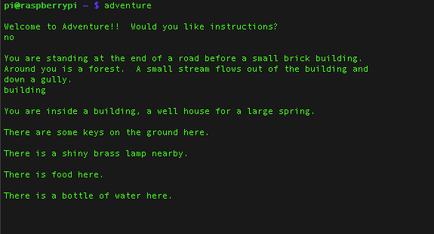
Today
Complete your game
Make sure it has an ending
Play each others games
Think about “testing” … is it easy to use? Are there any bugs? Is it fun?
Cheat codes – to test various puzzles, start the player with extra health or a key or at a specific location

Slide 8
today
Gather feedback on your game
Let students play the game
Show off your code, did you overcome any challenging problems?
Any funny bugs?

Slide 9
Extension tasks
Implement combat / NPCs / enemies
Multiple items per location
Wield a weapon

